Slide 1
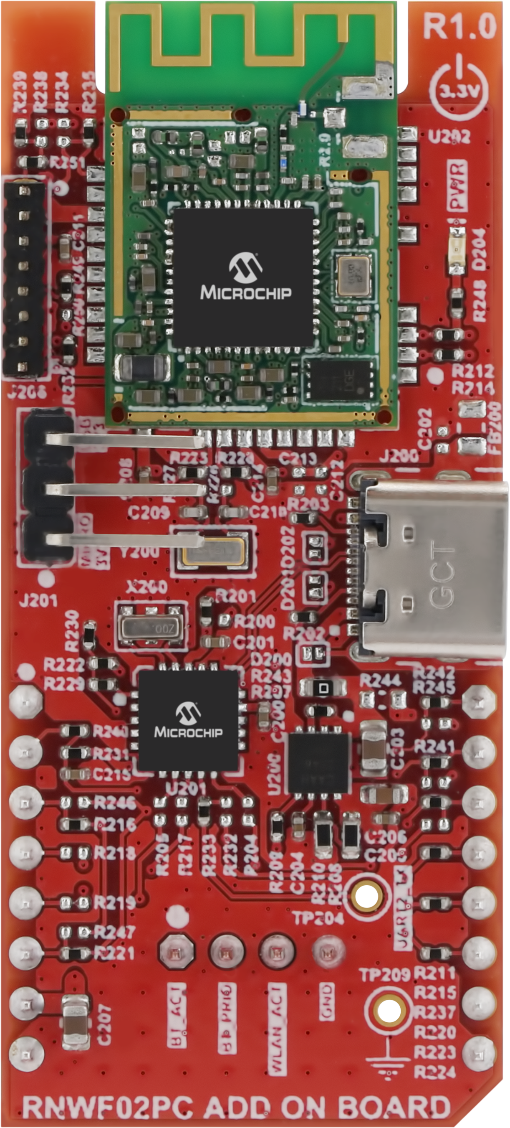
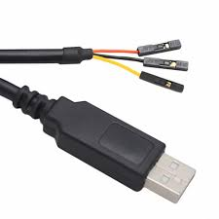
USB
to
UART
Converter
TX(14)
RXD
RX (13)
TXD
GND (9)
GND

